Slide 1

Construindo Pipelines de Dados para Machine Learning com BigQuery
JAIRO NEDER MONASSA MOREIRA

Slide 2

Passos
1 | Carregar dados do Kaggle para cloud storage
2 | Usando Dataflow template
3 | Copiando os dados para Bigquery
4 | Criando o dataset
5 | Criando Modelo
6 | Avaliando Modelo
7 | Realizando predições

Slide 3

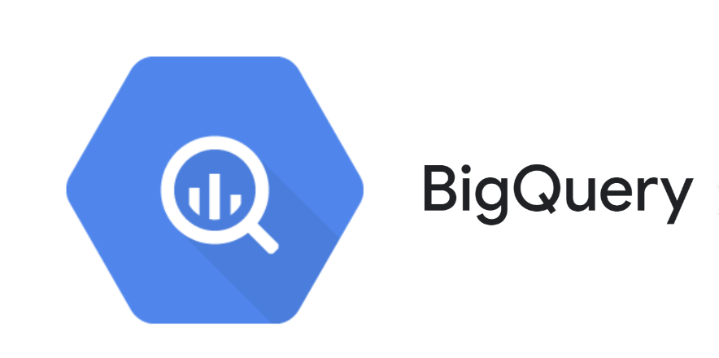
BigQuery
Escalabilidade
Serveless
Alto desempenho
Análise de petabytes em segundo
Armazenamento Colunar
Machine learning integrado
Alta disponibilidade
Segurança

Slide 4


Processamento em batch ou streaming
Serveless
Diversas integrações
Pode ser codado em python ou java

Slide 5


Facilita acesso ao ML
Usa linguagem SQL
Aumenta velocidade inovação
Integra outras ferramentas do GCP

Slide 6

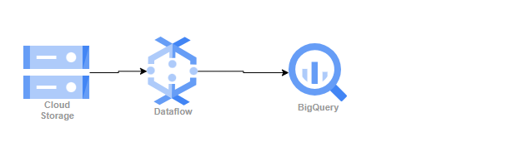
Hands-on

Slide 7

Vai precisar
Dataset Kaggle www.kaggle.com
Walmart Sales (kaggle.com)
https://console.cloud.google.com/ FreeTier 300 dólares

Slide 8

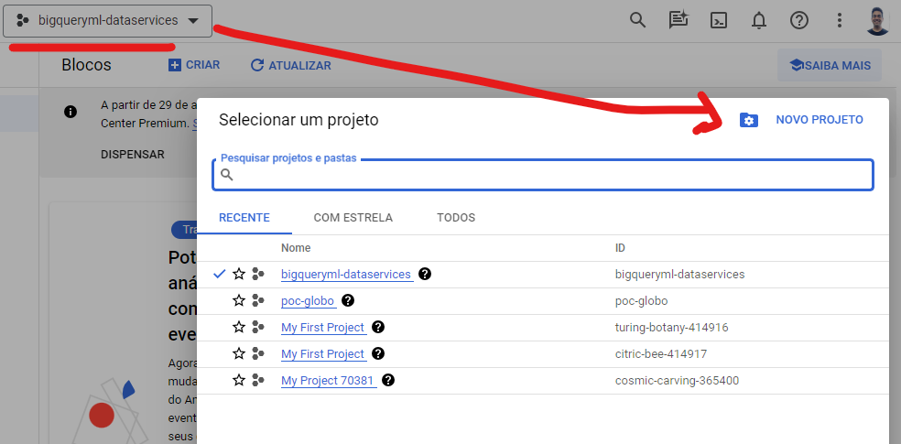
Criando novo projeto

Slide 9
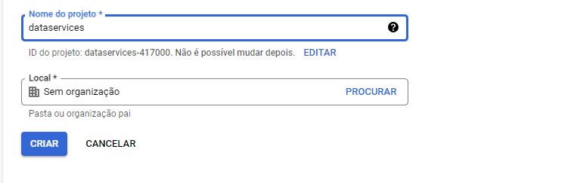
cont..

Slide 10

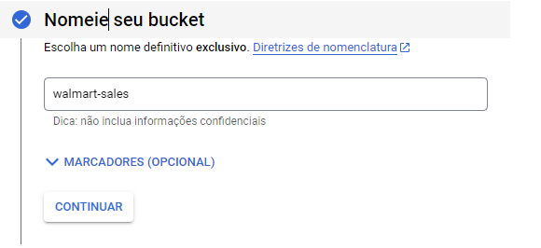
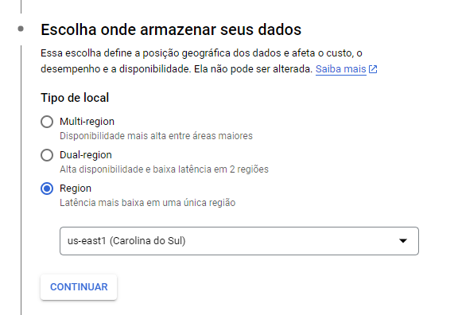
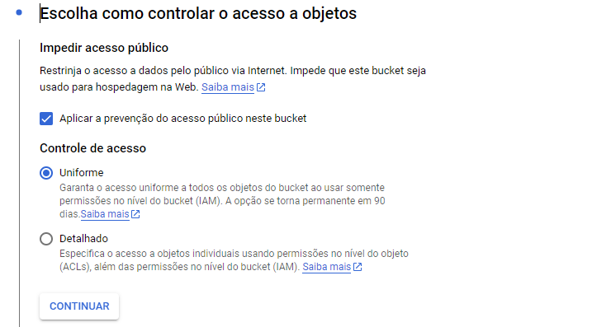
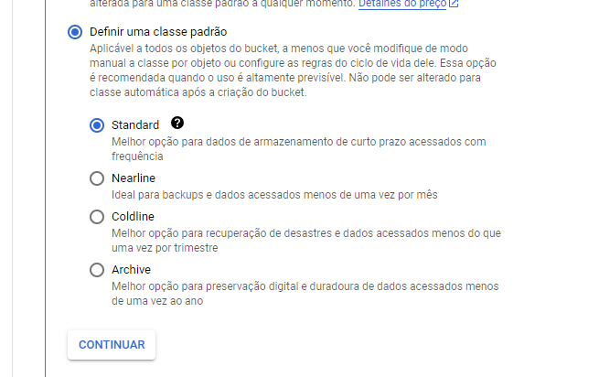
Criando cloud storage (cloud storage-> bucket)
1-

Slide 11
Dataset
1 - Download de dataset do Kaggle
2 - dê uma olhada no csv
3 - faça um schema do csv em json
3 - Faça upload do dataset no bucket recém criada
4 - Faça upload do schema no bucket

Slide 12
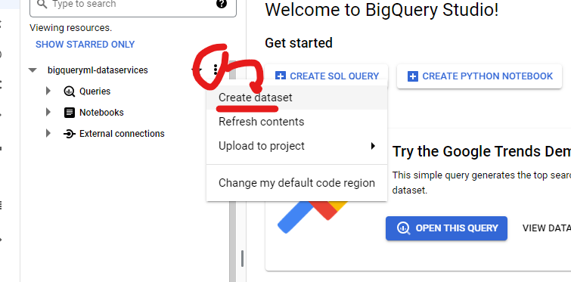
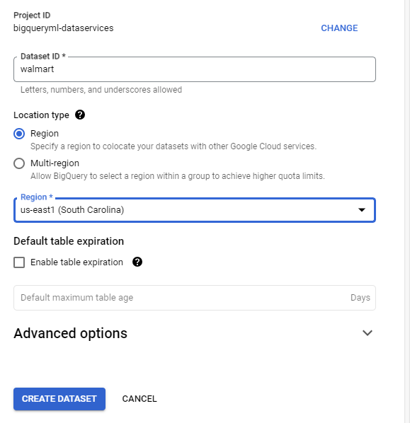
Crie um dataset no Bigquery

Slide 13
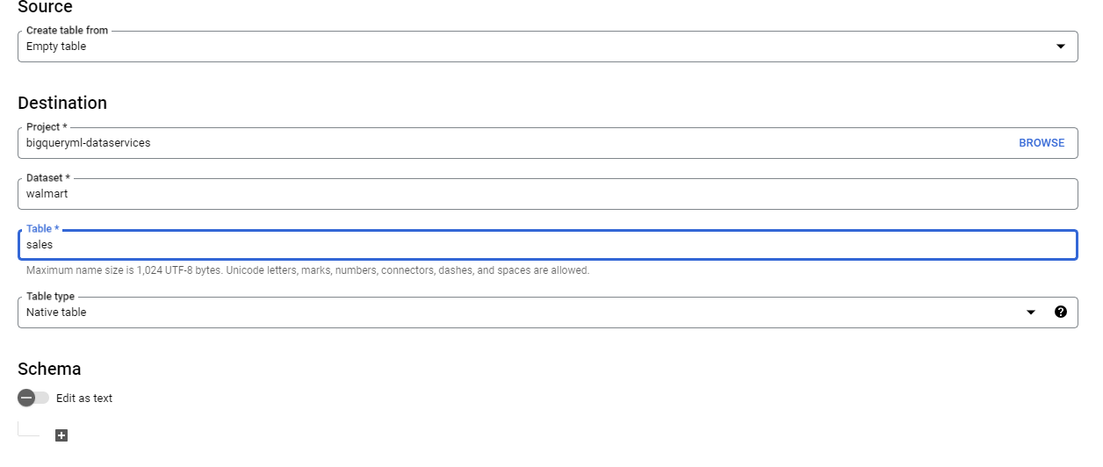
Crie uma tabela dentro do dataset
Não precisa definir schema

Slide 14
Habilitar API-Dataflow
API & Services => library
Search Daraflow=> enable

Slide 15
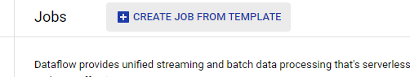
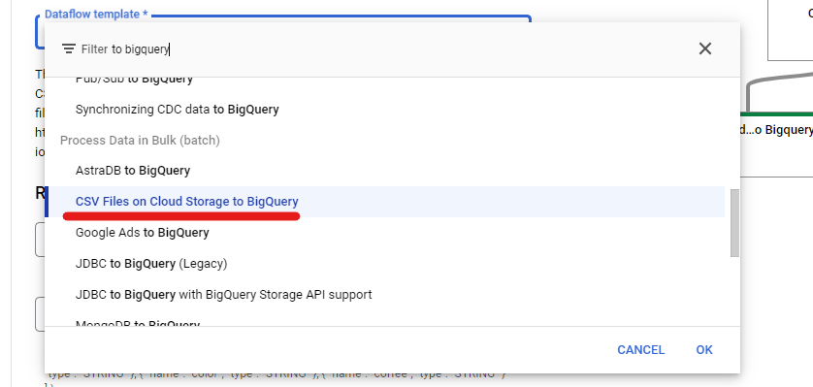
Job de Dataflow por template

Slide 16
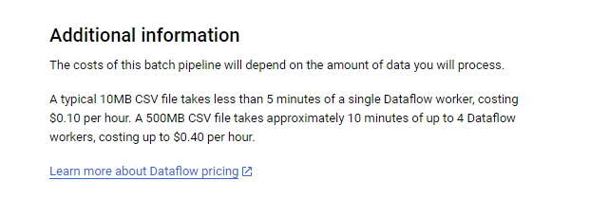
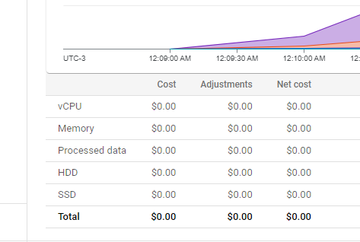
Veja os custos do dataflow

Slide 17
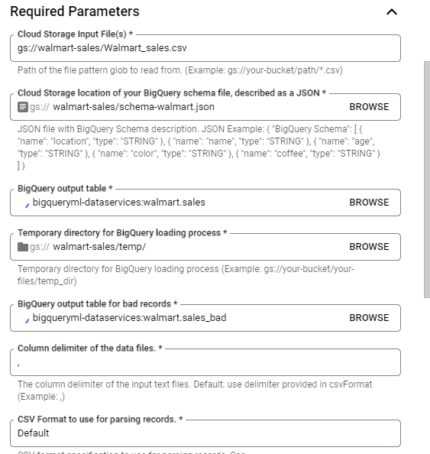
Required Parameters do dataflow
Bucket do csv
Schema em json
Tabela do Bigquery

Slide 18
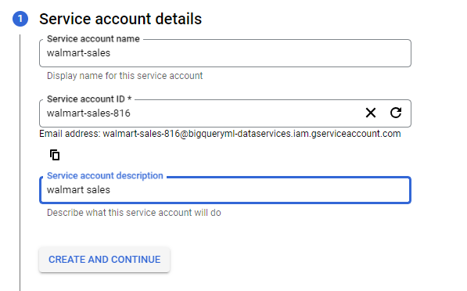
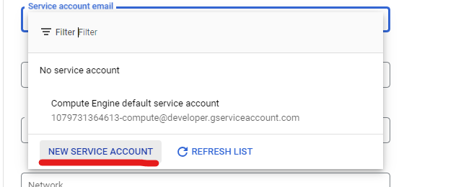
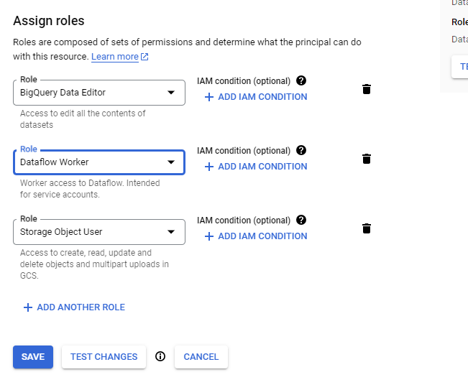
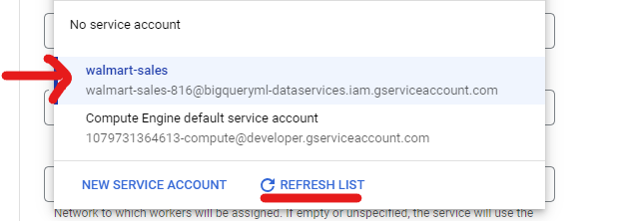
Service account
Roles Bigquery data editor, BigQuery Job User, Dataflow worker, storage objector user

Slide 19
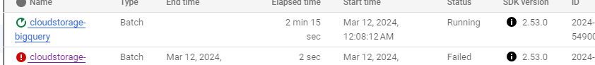
Run dataflow
Espere uns 5 min

Slide 20
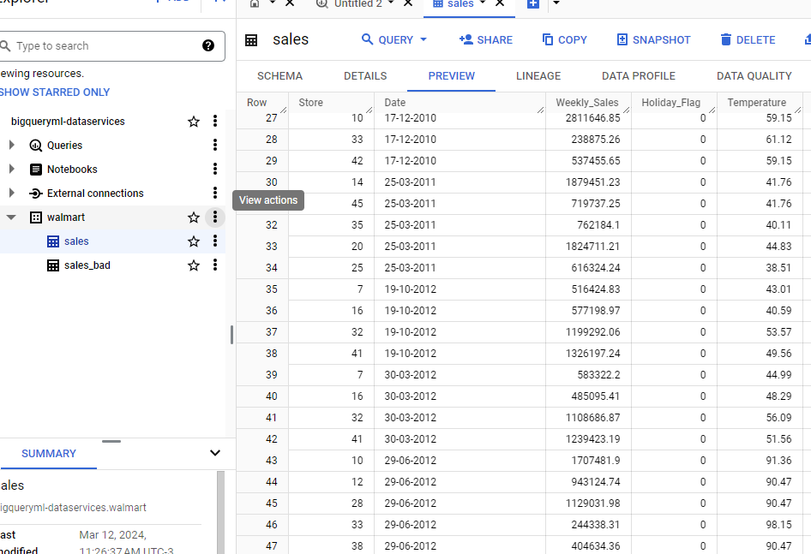
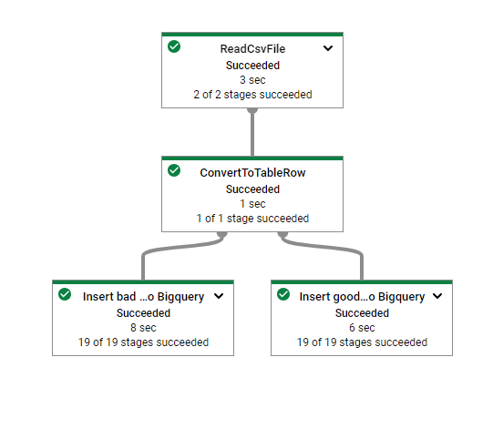
Sucesso
BigQuery

Slide 21
Recap
Dataset em csv no cloud storage transferido ao bigquery pelo dataflow

Slide 22
Analisando o dataset
#store => Storage number
#date sales =>week start date
#weekly_sales => store week sales
# holiday_flag => mark on the presence or absence of a holiday
#temperature => air temperature in the region
#fuel_price => fuel cost in the region
#cpi => consumer price index
#unemployment => unemployment rate

Slide 23
Criando o modelo via SQL
CREATE OR REPLACE MODEL `bigqueryml-dataservices.walmart.arima_model`
OPTIONS(
model_type='ARIMA',
time_series_timestamp_col='data_series',
time_series_data_col='Weekly_Sales',
DATA_FREQUENCY='DAILY',
time_series_id_col='store',
holiday_region='US'
) AS
SELECT
…..
Notes:
CREATE OR REPLACE MODEL `bigqueryml-dataservices.walmart.arima_model`
OPTIONS(
model_type='ARIMA',
time_series_timestamp_col='data_series',
time_series_data_col='Weekly_Sales',
DATA_FREQUENCY='DAILY',
time_series_id_col='store',
holiday_region='US'
) AS
SELECT
store,
-- Store,
CAST( PARSE_DATE('%d-%m-%Y', Date) AS TIMESTAMP) AS data_series,
cast(sum(Weekly_Sales) as float64) as Weekly_Sales
--Temperature,
--Fuel_Price,
--cpi,
--Unemployment
FROM
`bigqueryml-dataservices.walmart.sales`
group by Store, data_series

Slide 24
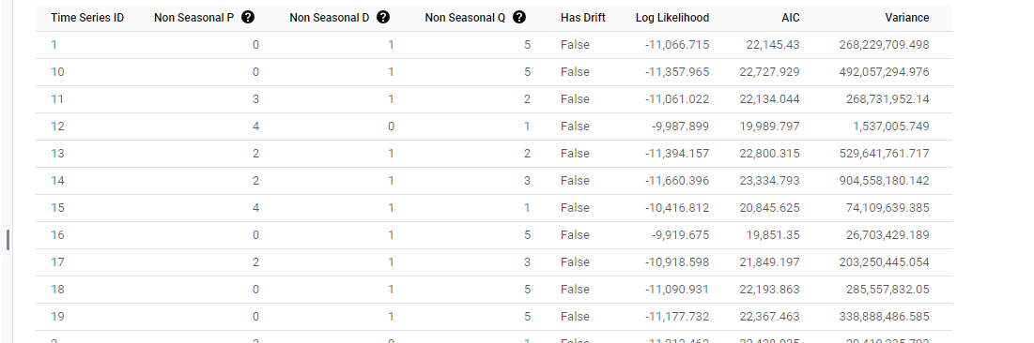
Verificar a evaluation
Notes:
SELECT
*
FROM
ML.EVALUATE(MODEL `walmart.arima_model`)
The following four columns (non_seasonal_{p,d,q} and has_drift) define an ARIMA model in the training pipeline. The three metrics after that (log_likelihood, AIC, and variance) are relevant to the ARIMA model fitting process.
The auto.ARIMA algorithm first uses the KPSS test to decide that the best value for non_seasonal_d is 1. When non_seasonal_d is 1, auto.ARIMA then trains 42 different candidate ARIMA models in parallel. Note that when non_seasonal_d is not 1, auto.ARIMA trains 21 different candidate models. In this example, all 42 candidate models are valid. Therefore, the output contains 42 rows, where each row is associated with a candidate ARIMA model. Note that for some time series, some candidate models are invalid as they are either non-invertible or non-stationary. These invalid models are excluded from the output, which will make the output have less than 42 rows. These candidate models are ordered by AIC in the ascending order. The model in the first row has the lowest AIC, and is considered as the best model. This best model is saved as the final model and is used when you call ML.EXPLAIN_FORECAST, ML.FORECAST, and ML.ARIMA_COEFFICIENTS as shown in the following steps.
The seasonal_periods column is about the seasonal pattern inside the input time series. It has nothing to do with the ARIMA modeling, therefore it has the same value across all output rows. It reports a weekly pattern, which is within our expectation as described in step two above.
The has_holiday_effect, has_spikes_and_dips, and has_step_changes columns are only populated when decompose_time_series=TRUE. They are about the holiday effect, spikes and dips, and step changes inside the input time series, which are not related to the ARIMA modeling. Therefore they are all the same across all output rows, except for those failed models.
The error_message column shows that the possible error incurred during the auto.ARIMA fitting process. A possible reason might be that the selected non_seasonal_p, non_seasonal_d, non_seasonal_q, and has_drift columns are not able to stabilize the time series. To retrieve the possible error message of all the candidate models, set show_all_candidate_models=true.

Slide 25
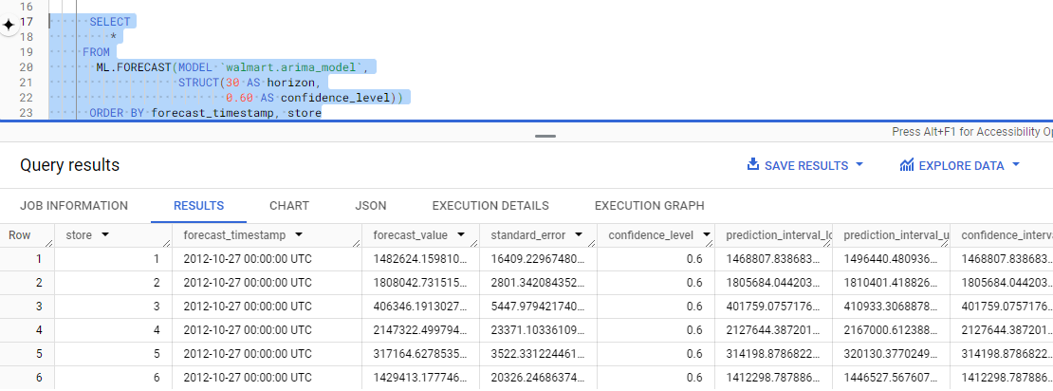
Previsão usando o comeando SQL
ML.FORECAST(MODEL ‘dataset.nomemodelo)
Notes:
When you train a time series model with BigQuery ML, multiple models/components are used in the model creation pipeline. ARIMA is one of the core algorithms available in BigQuery ML.
The components used are listed in roughly the order of the steps that are run:
Pre-processing: Automatic cleaning adjustments to the input time series, including missing values, duplicated timestamps, spike anomalies, and accounting for abrupt level changes in the time series history.
Holiday effects: Time series modeling in BigQuery ML can also account for holiday effects. By default, holiday effects modeling is disabled. But since this data is from the United States, and the data includes a minimum one year of daily data, you can also specify an optional HOLIDAY_REGION. With holiday effects enabled, spike and dip anomalies that appear during holidays will no longer be treated as anomalies. A full list of the holiday regions can be found in the HOLIDAY_REGION documentation.
Seasonal and trend decomposition using the Seasonal and Trend decomposition using LOgical regrESSion (Loess STL) algorithm. Seasonality extrapolation using the double exponential smoothing (ETS) algorithm.
Trend modeling using the ARIMA model and the auto. ARIMA algorithm for automatic hyper-parameter tuning. In auto.ARIMA, dozens of candidate models are trained and evaluated in parallel, which include p,d,q and drift. The best model comes with the lowest Akaike information criterion (AIC).

Slide 26
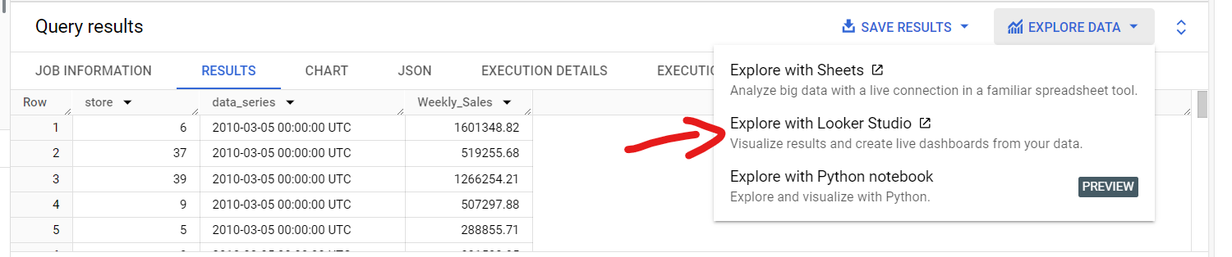
Explorando com BI (Looker studio)

Slide 27
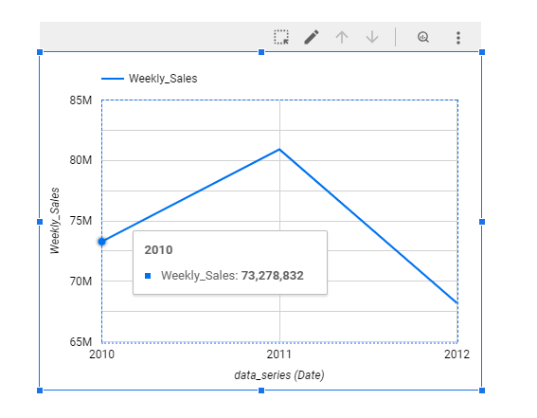
Gráfico time series

Slide 28
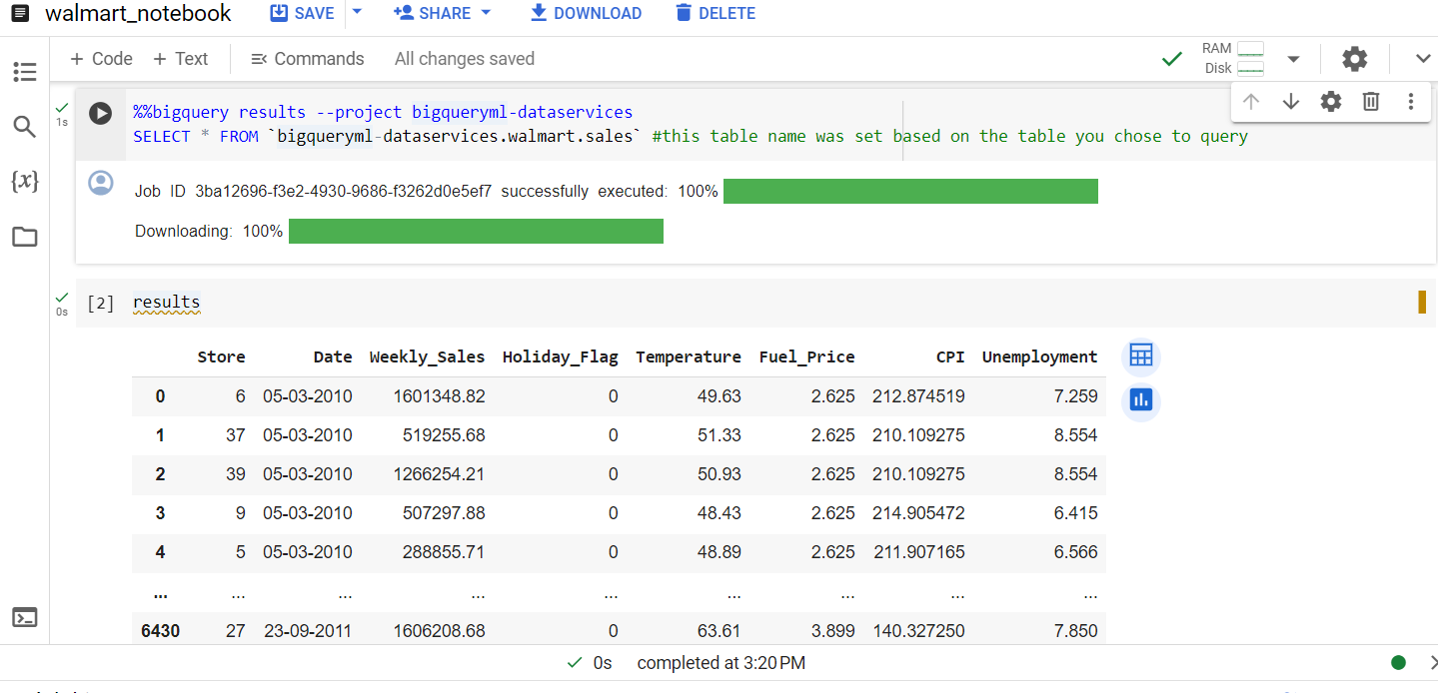
Explorando usando Notebook
Notes:
Commando magicos

Slide 29
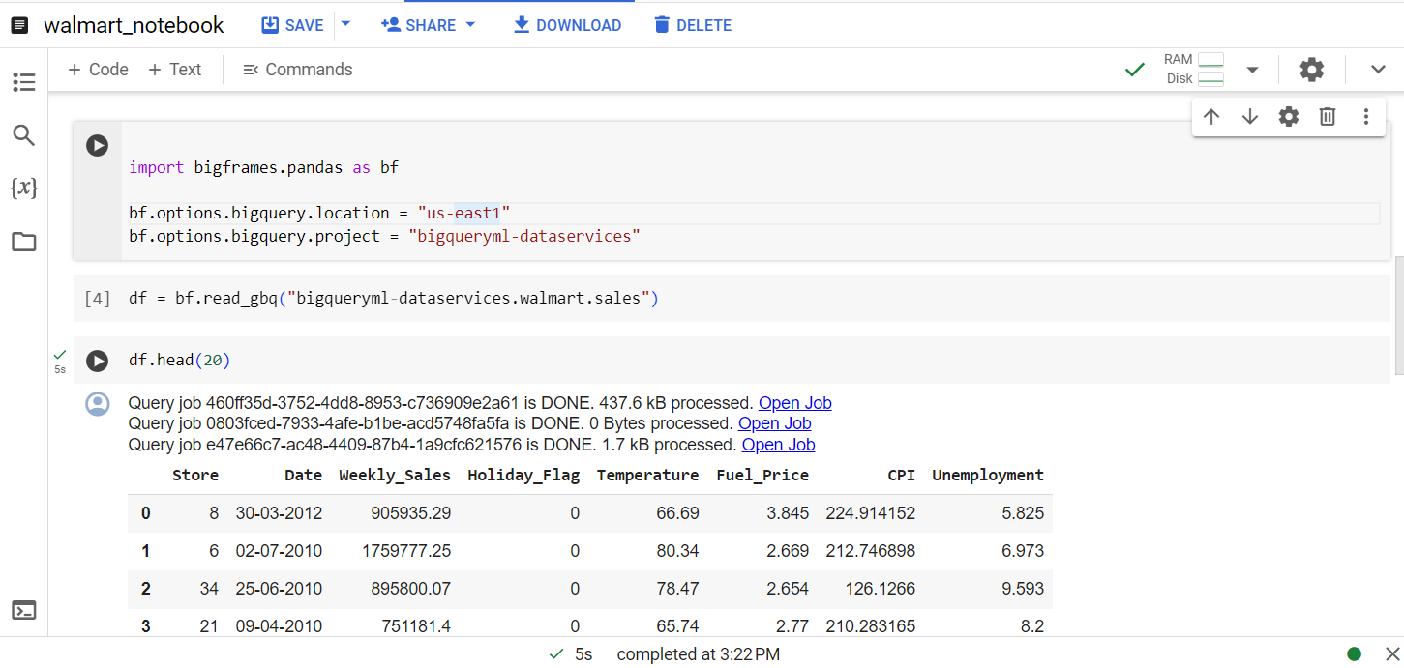
Notebook com pandas

Slide 30
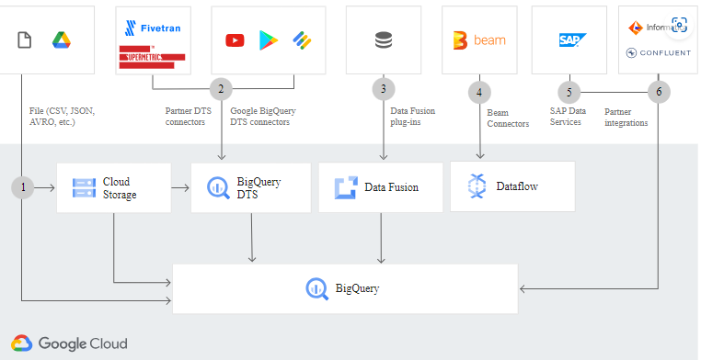
Outros tipos de ingestão
Notes:
bq load --autodetect --source_format=CSV --max_bad_records=100000 finance.fraud_data gs://$PROJECT_ID/$DATA_FILE

Slide 31
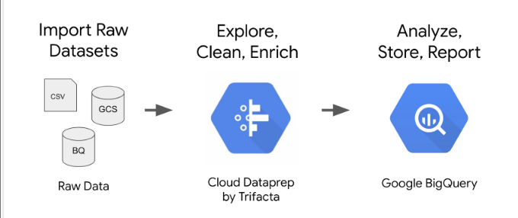
visual

Slide 32
Info sobre BigQuery
cloud.google.com/bigquery-ml

